Slide 1


UNIVERSITY INSTITUTE OF ENGINEERING
COMPUTER SCIENCE & ENGINEERING
Introduction to Information Security and Cryptography
(Subject Code:20CST-354/ITT-354)
Prepared By : Er. Puneet kaur(E6913)
INTRODUCTION
DISCOVER . LEARN . EMPOWER

Slide 2

El Gamal Digital Signature
www. cuchd.in Campus : Gharaun, Mohali

Slide 3
ElGamal Digital Signature Scheme
Involves the use of the private key for encryption and the public key for decryption.
We know that
For a prime number q, if α is a primitive root of q, then
α, α², …, α ^{q-1}
are distinct (mod q).
Global elements of ElGamal Digital Signature Scheme are prime number q and α (Primitive root of q).

Slide 4
ElGamal Digital Signature Scheme
Step-1
User A generates a private/public key pair as follows:
Generate a random integer X_{A}, such that 1 < X_{A} < q-1
Compute Y_{A} = α ^{XA} mod q
A’s private key is X_{A}
A’s public key is {q, α, Y_{A}}
Step-2
To sign a message M, user A first computes the hash m=H(M), such that m is an integer in the range 0 ≤ m ≤ q-1.

Slide 5
ElGamal Digital Signature Scheme
Step-3
User A forms Digital Signature:
Choose a random integer K such that
1 < K < q-1 and gcd (K, q-1)=1 // Relatively Prime
Compute S₁ = α^{K} mod q
Compute K⁻¹mod(q-1) // Inverse of K modulo q-1
4. Compute S₂ = K⁻¹(m - X_{A} S₁) mod (q-1)
5. The signature consists of the pair (S₁ , S₂)

Slide 6
ElGamal Digital Signature Scheme
Any user B can verify the signature as follows:
Compute V₁ = α^{m} mod q
Compute V₂ = (Y_{A}) ^{S1} (S₁) ^{S2} mod q
Signature is valid if V₁ = V₂

Slide 7
ElGamal Digital Signature Scheme
Example
Global elements of ElGamal Digital Signature Scheme are prime number q and α (Primitive root of q).
Let q=19 (Prime Number)
Primitive root of 19 are : {2, 3, 10, 13, 14, 15}
Let α = 10

Slide 8
ElGamal Digital Signature Scheme
Step-1
Generate a random integer X_{A}, such that 1 < X_{A} < q-1
Let X_{A} = 16
Compute Y_{A} = α ^{XA} mod q
Y_{A} = 10 ¹⁶ mod 19 = 4
3. A’s private key is X_{A} X_{A} = 16
A’s public key is {q, α, Y_{A}} Public Key = {19, 10, 4}

Slide 9
ElGamal Digital Signature Scheme
Step-2
User Alice wants to sign a message with hash value m=14
(m is an integer in the range 0 ≤ m ≤ q-1)
0 ≤ m ≤ 18

Slide 10
ElGamal Digital Signature Scheme
Step-3
User A forms Digital Signature:
Choose a random integer K such that
1 < K < q-1 and gcd (K, q-1)=1 // Relatively Prime
K=5, which is relatively prime to q-1 =18
Compute S₁ = α^{K} mod q
S₁ = 10⁵ mod 19 = 3

Slide 11
ElGamal Digital Signature Scheme
Compute K⁻¹mod(q-1) // Inverse of K modulo q-1
K⁻¹mod(q-1) = 5⁻¹mod(18) = 11
Compute S₂ = K⁻¹(m - X_{A} S₁) mod (q-1)
S₂ = 11(14 – 16x3) mod (18) = -374 mod 18 = 4
The signature consists of the pair (S₁ , S₂)
(S₁ , S₂) = (3, 4)

Slide 12
ElGamal Digital Signature Scheme
Any user B can verify the signature as follows:
Compute V₁ = α^{m} mod q
V₁ = 10¹⁴ mod 19 = 16
2. Compute V₂ = (Y_{A}) ^{S1} (S₁) ^{S2} mod q
V₂ = (4) ³ (3) ⁴ mod 19 = 5184 mod 19 = 16
Signature is valid because V₁ = V₂

Slide 13
ElGamal Digital Signature Scheme
Step-1
User A generates a private/public key pair as follows:
Generate a random integer X_{A}, such that 1 < X_{A} < q-1
Compute Y_{A} = α ^{XA} mod q
A’s private key is X_{A}
A’s public key is {q, α, Y_{A}}
Step-2
To sign a message M, user A first computes the hash m=H(M), such that m is an integer in the range 0 ≤ m ≤ q-1.

Slide 14
Digital Signature Standard (DSS)
A public-key technique.
DSS makes use of the Secure Hash Algorithm (SHA) and presents a new digital signature technique, the Digital Signature Algorithm (DSA)
DSS uses an algorithm that is designed to provide only the digital signature function.
It cannot be used for encryption or key exchange.
RSA approach of digital signature also provides encryption.

Slide 15
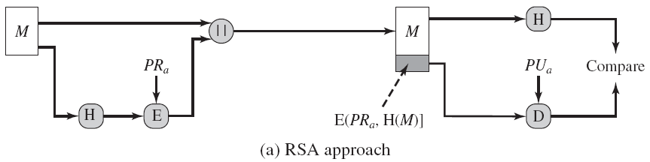
Digital Signature Standard (DSS)
Approaches of Digital Signature
RSA Approach

Slide 16
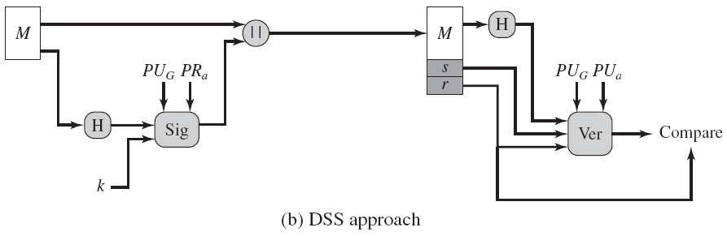
Digital Signature Standard (DSS)
DSS Approach

Slide 17
Digital Signature Standard (DSS)
DSS Approach…
Uses Hash functions.
The hash code is provided as input to a signature function along with a random number k generated for this particular signature.
The signature function also depends on the sender’s private key (PRa) and a set of parameters known to a group of communicating principals.

Slide 18
Digital Signature Standard (DSS)
DSS Approach…
This set constitutes a global public key (PU_{G}).
Result of signature function consists of two components, labeled s and r.
At the receiving end, the hash code of the incoming message is generated.

Slide 19
Digital Signature Standard (DSS)
DSS Approach…
Generate hash code + signature is input to a verification function.
The verification function also depends on the global public key as well as the sender’s public key
The output of the verification function is a value that is equal to the signature component r if the signature is valid.

Slide 20
Digital Signature Algorithm (DSA)
Global Public-Key Components :
Three public parameters and common to a group of users.
A 160-bit prime number q is chosen.
Next, a prime number p is selected with a length between 512 and 1024 bits such that q divides (p - 1)
Finally, g is chosen to be of the form h^{(p-1)/q} mod p, where h is an integer between 1 and (p-1) with the restriction that must be greater than 1.

Slide 21
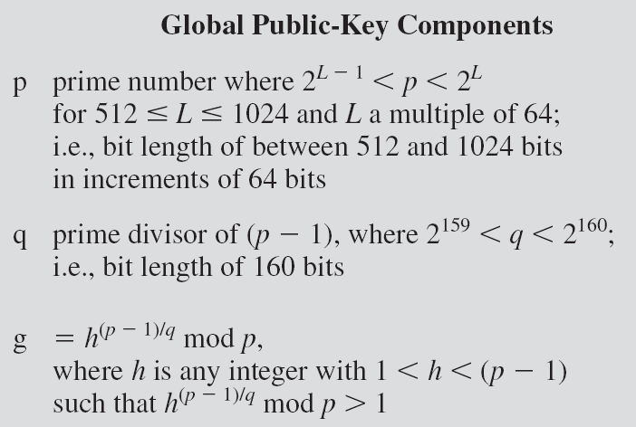
Digital Signature Algorithm (DSA)

Slide 22
Digital Signature Algorithm (DSA)
User’s Private Key
The private key x must be a number from 1 to (q-1) and should be chosen randomly or pseudorandomly.

Slide 23

Digital Signature Algorithm (DSA)
User’s Public Key
The public key is calculated from the private key as
y = g^{x} mod p
However, given the public key y, it is believed to be computationally infeasible to determine x.

Slide 24
Digital Signature Algorithm (DSA)
User's Per-Message Secret Number
k = random or pseudorandom integer with 0 < k < q
Signing
To create a signature, a user calculates two quantities r and s, that are functions of the public key components (p, q, g), the user’s private key (x) , the hash code of the message H(m), and an additional integer k .

Slide 25
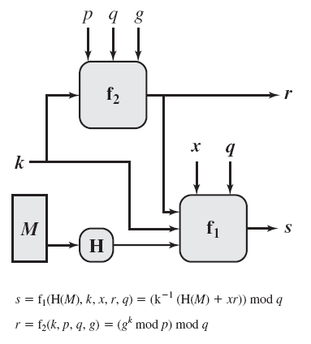
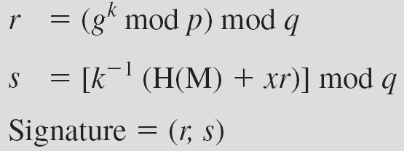
Digital Signature Algorithm (DSA)

Slide 26
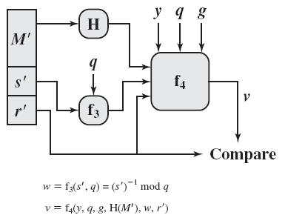
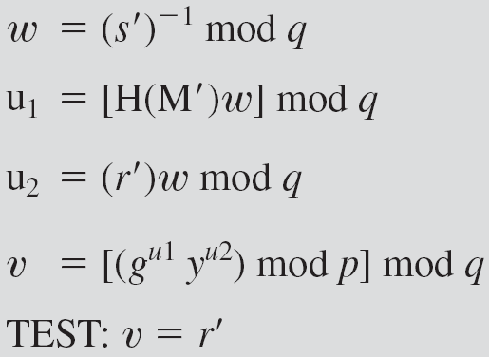
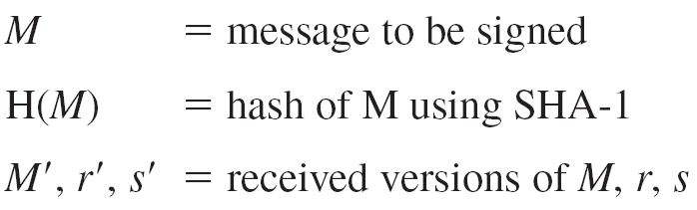
Digital Signature Algorithm (DSA)
Verification

Slide 27
References
http://www.brainkart.com/article/Classical-Encryption-Techniques_8339/
https://www.tutorialspoint.com/cryptography/index.htm
https://www.geeksforgeeks.org/cryptography-introduction/
https://www.techopedia.com/definition/1770/cryptography#:~:text=Cryptography%20involves%20creating%20written%20or,information%20to%20be%20kept%20secret.&text=Information%20security%20uses%20cryptography%20on,transit%20and%20while%20being%20stored.
https://www2.slideshare.net/lineking/classical-encryption-techniques-in-network-security?qid=e388c29f-793d-4f2b-bcaf-9d22e9ca07b5&v=&b=&from_search=1

Slide 28
E- Books Recommended
https://www.pdfdrive.com/cyber-security-books.html
https://bookauthority.org/books/new-cyber-security-ebooks
https://bookauthority.org/books/best-cyber-security-ebooks
https://www.freetechbooks.com/information-security-f52.html

